Slide 1
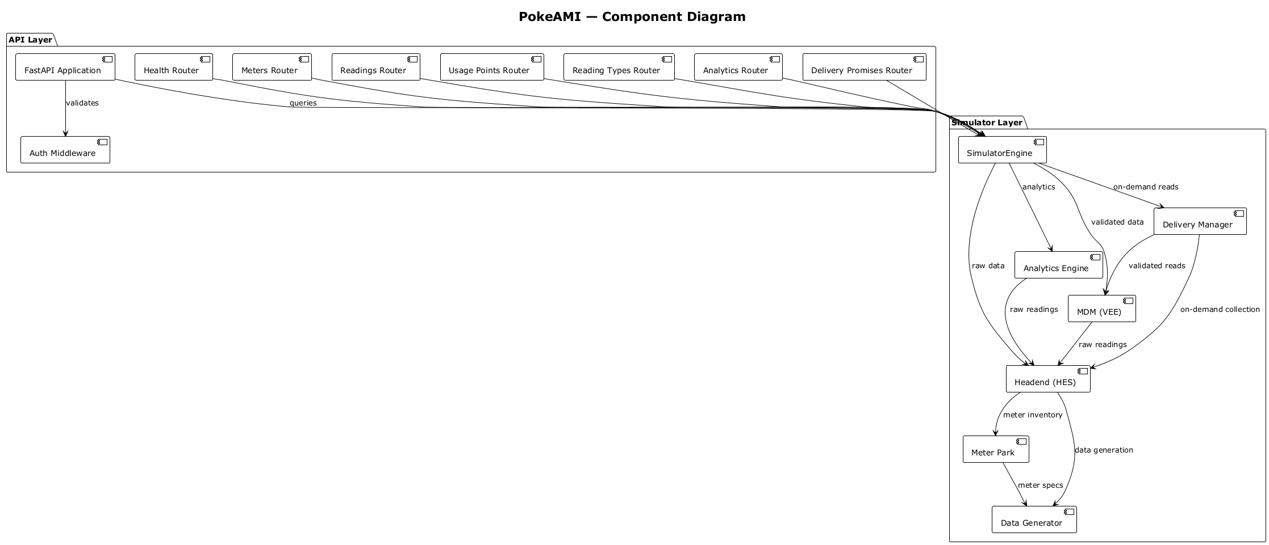
PokeAMI — Component Diagram
validates
queries
on-demand reads
analytics
validated data
raw data
validated reads
on-demand collection
raw readings
raw readings
meter inventory
data generation
meter specs

